Slide 2
Psychological research and its specifics
Topic 1. The author is associate professor A.A. Lytko
According to the UNESCO rule, "experiments on living people are only allowedwith their full consent."

Slide 3
Introduction
There are several classifications of research methods that are used in psychology.

Slide 4
Classification 1 (general psychology)
Methods of psychology are divided into basic and auxiliary.
The main ones – are observation and experiment.
Auxiliary – questionnaires, interviewing, the method of generalization of independent characteristics (expert assessments), the method of studying the products of activity, etc.

Slide 5
Classification 2 (according to B. G. Ananyev)
Organizational methods – comparative (cross-sections), longitudinal (longitudinal sections), complex.
Empirical methods – observation, experiment, questionnaires, interview, biographical, product analysis, etc.
Methods of data processing – quantitative and qualitative analysis.
Interpretation methods – genetic and structural.

Slide 6
Classification 3 (Western European Psychology)
Descriptive methods (natural observation, descriptive observation, questionnaire, test, correlation analysis, etc.)
Experimental methods (laboratory and natural, ascertaining and forming, etc.)
And now let's move onto the plan ofpresentation of the material.

Slide 7
Plan of the lecture
1 Descriptive methods
2 Experimental method
3 Organization of experimental research
We wish you all educational success

Slide 8
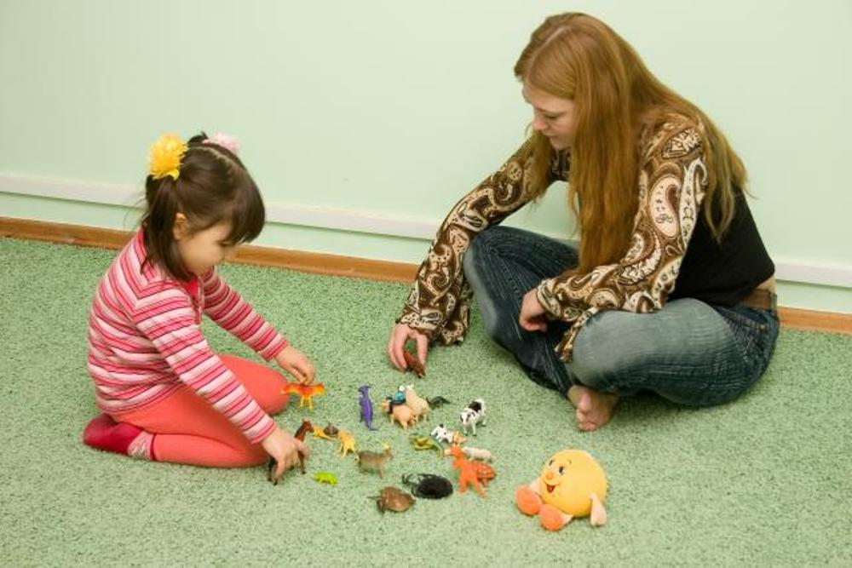
1 Descriptive methods
Observation is one of the main methods of collecting primary information, consisting in
systematic, purposeful perception and fixation of mental phenomena in certain conditions.
http://boombob.ru/img/picture/Jul/06/f3ddb4c42a9cbdf97f95e2e552435e34/12.jpg

Slide 9
The most commontypes
of surveillance
Indirect
Contact
By contact
Field services
Laboratory tests
According to the terms of activity
Included
Not included
By the nature of interaction with the subject
Open
Secretive
Solid
Selective
By time
Random
Directed
By goals

Slide 10
Observation in natural conditions (field)
Let's consider some types of observation
The observer must keep out of the way so as to remain unnoticed, or else blend in so well with the group as not to attract attention.
At the same time, he must notice and evaluate all events related to the phenomenon to be described.

Slide 11
Systematic observation
Example of the protocol
№ | Child's name | Featuresof the motor sphere |  |  | Specific motor manifestations
1 | Kohl's | Motor clumsy awkward, poorly coordi-nated | A lot of unnecessary movements, impulsive | The movements are slow, the child is sluggish, apathetic | In movements prefers the left arm, leg | The presence of neurotic movements, tics | The presence of pretentious stereotypi-cal movements
2 | etc | … | … | … | … | … | …
3 | …

Slide 12
Questionnaires
Questionnaires provide an opportunity to get information about large groups of people by interviewing some part of these people who make up a representative (representative) sample.
Large firms engaged in probing public opinion usually receive results that deviate from the results of the survey of the entire population by no more than 3-4 % in both directions.

Slide 13
Test
– a standardized method for measuring the various characteristics of individuals who serve as objects of observation.
Tests allow you to evaluate intellectual or perceptual abilities, motor functions or personal characteristics, the threshold of anxiety, etc.

Slide 14
Example of a test for learning ability by A. Y. Ivanova
http://shop.imaton.com/mod_files/catalog_1_images/img_img_catalog_1_images_597.jpg

Slide 15
Correlation analysis method (example)
Can we assume that 17-18-year-old female students are more sociable than boys of the same age?
To answer this question, it is enough to establish a relationship between the data obtained as a result of observation or testing. In particular, it is necessary to compare, for example, the estimates of sociability of girls with the corresponding estimates for boys.
Such dependencies are evaluated mainly using statistical methods. Most often, the correlation coefficient is calculated.

Slide 16
Lack of the correlation analysis method
This method, however, does not solve the problem associated with the possible interpretation of the dependence that exists between variables.
For example, when studying aggression in children, it turned out that violent children are more likely than others to watch TV movies with scenes of cruelty.
Does this mean that such a spectacle engenders aggressiveness in them, or, on the contrary, violent spectacles attract the most aggressive children? How do you determine which of these two variables is the cause and which is the effect?
Correlation analysis does not answer such questions.

Slide 17
Let's remember the lecture plan
1 Descriptive methods
2 Experimental method
3 Organization of the pilot study
Consider 2 Experimental method.
Let's start with a small example.

Slide 18
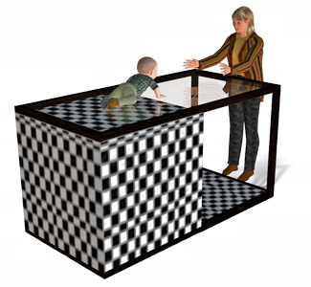
The Visual Cliff study was developed by Walk & Gibson. The experiment is used to answer the question: Do babies perceive depth?
It is used to assess the perception of depth, or "cliff". This question has both theoretical and practical significance.
http://factroom.trusttown.net/facts/wp-content/uploads/2012/08/4.png
It is used to assess the perception of depth, or "cliff". This question has both theoretical and practical significance.

Slide 19
"Visual clipping" is shown in the figure. The fixture consists of a large table with a glass cover in two halves.
One side of the plaid fabric is directly adjacent to the glass, giving the impression of a hard surface. This part is called "shallow".
http://factroom.trusttown.net/facts/wp-content/uploads/2012/08/4.png
On the other side, the fabric is located below the glass level, giving the impression of a break. This part is called "deep".
The mother tries to persuade the baby to crawl to her on the glass. Will the baby crawl along the "shallow" side and refuse to crawl along the "deep" side? If this happens, it can be concluded that the infant perceives depth.

Slide 20
http://factroom.trusttown.net/facts/wp-content/uploads/2012/08/4.png
Research shows that as early as 6 months of age, babies tend to avoid the “deep” side by demonstrating the ability to perceive depth.

Slide 21
So, 2 Experimental method
The disadvantages of correlation analysis are related to the fact that it allows only to state the presence of some connection between certain parameters, but cannot prove that this connection is a causal relationship.
The most effective way to identify this dependence is to intervene to determine how the presence or absence of one factor affects the other. This kind of intervention is the essence of the experimental method.

Slide 22
Definition of the concept
An experiment is one of the main methods of collecting information, characterized by the fact that the researcher systematically manipulates one or several variables and fixes changes in the manifestation of another, studied variable.

Slide 23
Experimental group and control group
The experiment consists in the fact that the initial group is divided into two, either randomly or on the basis of criteria chosen by the experimenter (for example, the same number of persons of both sexes, etc.).
One of them is the experimental group on which the study is being conducted. The experimental group consists of individuals who will be exposed to the independent variable.
And the second group is the control one. The control group is similar to the experimental group. It is placed in the same conditions as the experimental one, except that the subjects in it are not exposed to the experimental influence (independent variable).

Slide 24
Types of variable factors in the experiment
Independent variable.
Dependent variable.
Controlled variables.
Intermediate variables.

Slide 25
Variable factors in the experiment
Independent variable.
This is, first of all, the one that was introduced by the experimenter, which he will change and the effect of which he wants to evaluate.
In an experiment, psychologist Milgram tried to clarify how much suffering ordinary people are willing to inflict on others if they receive the appropriate orders.
http://wilds.biz/uploads/posts/2015-10/1443973828_performance-jamie-charles.jpg
3
2
1
1- the psychologist-experimenter asks subject 2 to send electric current to person 3 over and over again behind the wall. Each next button gives an electric shock stronger than the previous one, if 3 makes a mistake in solving problems. Thanks to the tape recorder, man 3 “screams” more and more terribly every time. Subject 2 does not know that the person behind the wall is just a psychologist's assistant. To what extent will (button) 2 "torture" 3 if the psychologist orders the experiment to continue?
The independent variable here is the order of the psychologist.
Notes:
1- the psychologist-experimenter asks subject 2 to send electric current to person 3 over and over again behind the wall. Each next button gives an electric shock stronger than the previous one, if 3 makes a mistake in solving problems. Thanks to the tape recorder, man 3 “screams” more and more terribly every time. Subject 2 does not know that the person behind the wall is just a psychologist's assistant. To what extent will (button) 2 "torture" 3 if the psychologist orders the experiment to continue?
The independent variable here is the order of the psychologist.

Slide 26
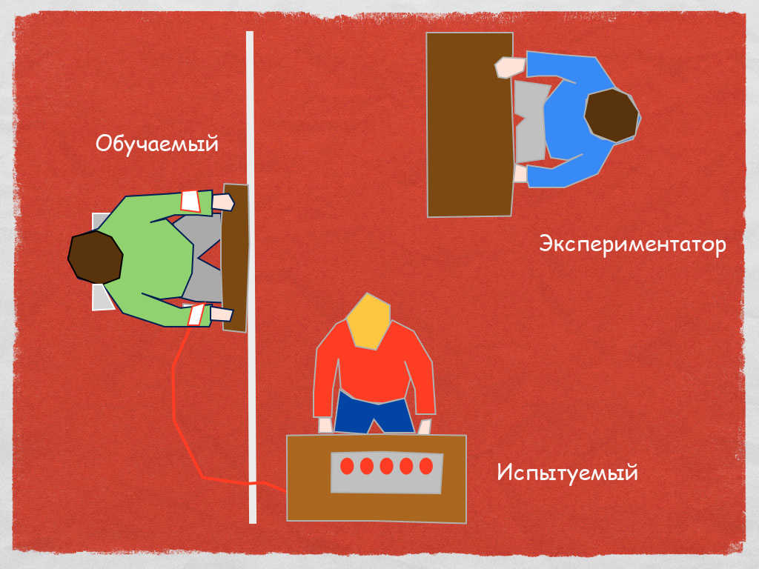
Переменные факторы в эксперименте
Since changes in behavior, a person's attitude to certain situations depend on experimental manipulation, these variables are called dependent variables.
The dependent variable here is the suffering that ordinary people are willing to inflict on other people.
This variable can be measured by the number of buttons that the subject typed during the experiment.
Dependent variables.
psychologist assistant
1
psychologist
3
2
test subject
http://froid.su/uploads/images/milgram.jpg
Milgram's experiment
(Milgram Obedience Experiment)

Slide 27
Variable factors in the experiment
Controlled variables.
As for all other variables, they are strictly controlled to avoid their variation from one subject to another and from session to session. As a rule, in modern experimental research, such psychological characteristics of individuals as intelligence, gender, age, social position (status), etc., are taken into account as variables that are controlled by the experimenter.

Slide 28
Variable factors in the experiment
Intermediate variables
There are variables that cannot be controlled, since they constitute an integral part of every subject: his psychological state during the experiment, interest or indifference to such tests or reaction to the experiment.
These are so-called intermediate variables that lie between the independent and dependent variables and should be taken into account when interpreting the results.

Slide 29
Variable factors in the experiment
Thus, experimenting means studying the effect of an independent variable (i.e., a factor that the experimenter can arbitrarily change) on one or several dependent (i.e., directly dependent on the subjects and on the phenomenon under study) with strict control of all other variables, called controlled.

Slide 30
Experiment: pros and cons
Advantages
Disadvantages
Provides high accuracy of results
The conditions of the subjects' activity do not correspond to reality
The study can be repeated under similar conditions
Subjects know they are subjects of research
Almost complete control is exercised over all variables
Analyze the scheme yourself

Slide 31
Recall the lecture plan
1 Descriptive methods
2 Experimental method
3 Organization of experimental research
Consider 3 Organization of experimental research

Slide 32
3 Organization of experimental research
The following research stages can be distinguished:
indicative;
development of an experiment plan;
actual experimentation;
processing of experimental data;
analysis and interpretation;
scientific report (publication).
Consider them

Slide 33
3 Organization of experimental research
indicative;
It includes preliminary observation of the object of research, the study of the conditions for its manifestation, the formulation of guesses about the possible connection of any facts or events with each other. Relevant scientific literature is being studied. The stage ends with the formulation of a working (or preliminary) research hypothesis.

Slide 34
3 Organization of experimental research
2 ) development of an experiment plan;
formulation of research tasks based on a hypothesis;
selection of factors that will act as an independent variable (changeable only according to the experimenter's plan) and a dependent variable (changing as a result of a change in the independent variable);
an analysis of all the circumstances of the experimental situation is carried out to identify additional variables that may affect the results of the experiment;
methods are selected and experimental techniques are developed.
If the experiment is connected, for example, with the study of opinions, attitudes, then the survey method can be chosen. If it is a study of behavior, then a method of observation, etc. At the same time, depending on the tasks of the study, existing experimental techniques are selected or new ones are developed.

Slide 35
3 Organization of experimental research
actual experimentation;
Often it includes a pilot (trial) study, the task of which is to formulate a hypothesis more accurately, to refine the methods by checking them for reliability, and, in addition, to check whether the intended experimental design is successful, i.e. close to a flawless experiment. The closer the results of a practical experiment to the ideal, flawless, the higher its validity (suitability).
After the pilot, a series of basic experiments are conducted, the task of which is to collect primary data.

Slide 36
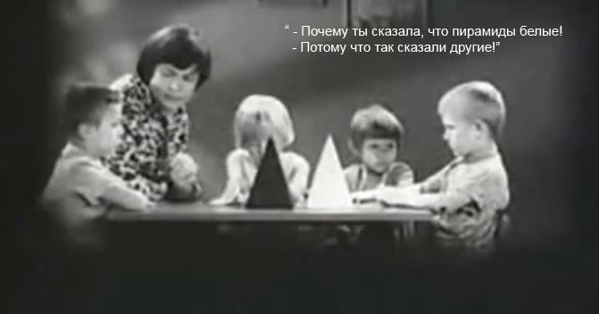
One of the experiments on suggestibility
http://www.videosort.ru/images/content/experiment/post/experiment_child.jpg
Why did you say the pyramids are white?
Because others have said so.

Slide 37
3 Organization of experimental research
The researcher in the experiment deals with people. He is obliged to adhere to a number of principles of scientific ethics.
The main ones are: the principle of voluntary participation of the subjects in the experiment, the use of the obtained information only for scientific purposes, the obligatory removal of insufficient quality information from the experimental data.
This is due to the fact that the main thing in any research is to obtain reliable and reliable information, otherwise all further research loses its meaning.

Slide 38
3 Organization of experimental research
4) Processing of experimental data
involves the use of quantitative and qualitative methods of processing the information received.
At the same time, methods of mathematical statistics, scaling techniques, and computer data processing are actively used.
The main purpose of using mathematical statistics is to increase the validity of the conclusions of psychological research through the use of probabilistic logic, i.e. confirm or refute the hypothesis of the study.

Slide 39
An example of a graphical presentation of data
1 - sanguine type
2 - choleric type
3 - melancholic type
4 - phlegmatic type
2
3
4
1
Shown here is the ratio of temperament types in the group of subjects according to the Eysenck test indicators

Slide 40
3 Organization of experimental research
5) analysis and interpretation of the results obtained;
This process is creative, not subject to clear algorithms.
The findings usually correlate with other theoretical and empirical studies.
It is at this stage that the imagination and scientific culture of the experimenter are most manifested, who turns the data of experimental measurements into meaningful results.

Slide 41
3 Organization of experimental research
6) publication of the message;
Any well-conducted research, once completed, should be the subject of a public message.
The main goal is not only to inform others about the results obtained, but also to enable them to reproduce the given experiment under identical conditions in order to confirm the conclusions drawn or to improve some details.
In addition to describing the hypotheses, performed procedures and processing the results, the message should contain a discussion of the data obtained, which may raise new questions.

Slide 42
Plan of the lecture
1 Descriptive methods
2 Experimental method
3 Organization of the pilot study
All questions are considered

Slide 43
Additional information for curious undergraduates!
The next three slides show how scientific misconceptions have arisen in some studies in evaluating the experimental data obtained.

Slide 44
Дополнительная информация для любопытных магистрантов !
На следующих трёх слайдах показано, как в некоторых исследованиях возникали научные заблуждения в оценке полученных экспериментальных данных.

Slide 45
Возможные искажения
Эффект Пигмалиона (или эффект Розенталя)
Пигмалион был греческим скульптором, который по преданию изваял статую столь прекрасную, что влюбился в нее и умолил богов оживить ее.
Американский психолог Розенталь (1966) назвал именем Пигмалиона явление, состоящее в том, что экспериментатор, твердо убежденный в обоснованности какой-то гипотезы, непроизвольно действует так, что она получает фактическое подтверждение.

Slide 46
Возможные искажения
Эффект Хоторна
Как показали опросы, проведенные промышленными психологами на предприятиях Хоторна в Чикаго, одно лишь участие в эксперименте оказывает на испытуемых такое влияние, что очень часто они ведут себя именно так, как ожидают от них экспериментаторы.

Slide 47
Возможные искажения
Эффект Барнума
«Каждую минуту на свет рождается простофиля», - утверждал Финеас Т. Барнум.
Именем основателя знаменитого цирка была названа склонность людей принимать за чистую монету описания или общие оценки своей личности, если эти оценки преподносятся под научным, магическим или ритуальным соусом.
Такой эффект хорошо известен астрологам, ведущим ежедневную рубрику в газетах.

Slide 48
https://www.ljubljuknigi.ru
The author of this book is your teacher. It can be ordered online at the specified address.

